Slide 1
Online Product Quantization
Donna Xu etc.
TKDE 2018

Slide 2
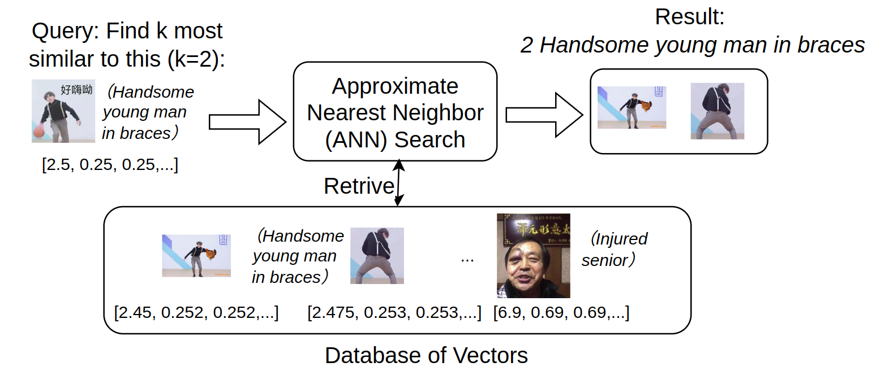
Approximate Nearest Neighbor (ANN) Search
Notes:
Approximate Nearest Neighbor Search is a key operation in managing high dimensional vectors in a database, such as pictures, word embeddings and so on.
Here is an example of ANN of information retrieval. In this example, we have saved various images in a database, and each image is encoded as a high dimensional vector, such as this [2.45, 0.252...]. 1.The different value vectors refer to different image content, such as Handsome young man in braces and injured senior.
2.Given an user query of finding k most similar content (k=2), the database will conduct ANN to deliver the desired result. Specifically here, 3.
we can find 2 Handsome young man in braces as the results, as they are most close to the query vector around [2.5, 0.25,0.25...]

Slide 3
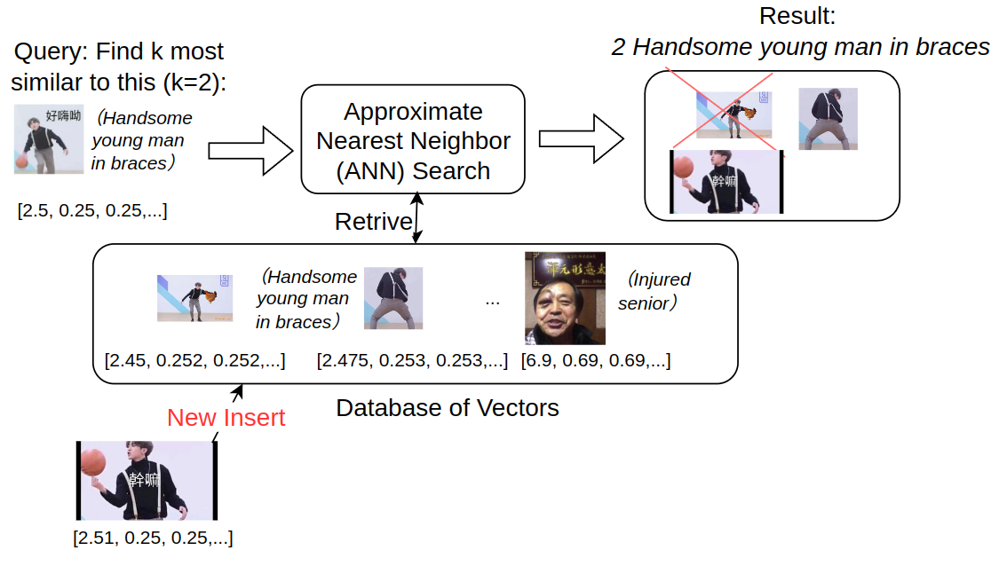
ANN Search on a Dynamic Database
Research Problem:
an online approach accommodating the new streaming data with low computational cost for ANN search
Notes:
In the last slide, we have assumed a static database content of ANN. However, things can be more complicated when the database is dynamically ingesting and deleting data. For image retrieval in dynamic
databases [3], relevant images are retrieved from a constantly changing image collection, and the retrieved
images could therefore be different over time given the
same image query. In such an environment, real-time query needs to be answered based on all the data collected
to the database so far.
In this shown picture, the new insert content is even more similar to the query, as the handsome man is playing with a basketball, instead of chicken there, subsequently, the
Result should be updated as shown above.
To efficiently serve this kind of dynamic database applications, there is a need of developing an online
approach accommodating the new streaming data
with low computational cost for ANN search

Slide 4
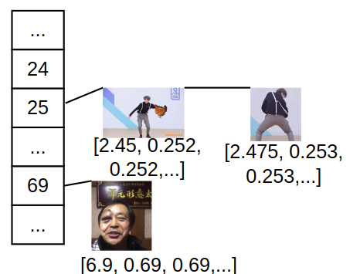

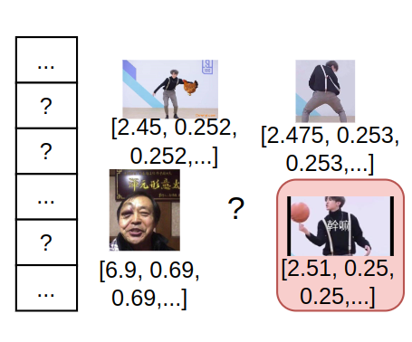
Challenge of Indexing for Online ANN Search
New insert
Indexing for ANN Search: "The more similar, the closer"
How to accurately maintain the indexing with low computational complexity and storage cost in the online setting?
Notes:
Indexing is a notorious challenge for general data management, and it is even harder for online ANN Search. To support efficient retrieval of high dimensional vectors, we need to organize similar vectors close to each other in ANN search. For instance, the vectors of handsome man in braces can be placed together at the 25th region of a list or array,
while that for injured senior is at 69 region. After an update of data base, we still want the principle of "The more similar, the closer" hold, which requires the indexing method to be updated accordingly.
Due to its significant impact of result accuracy and costly nature, a question arises as 'how to accurately maintain the indexing with low computational complexity and storage cost "

Slide 5
None of existing work can answer it well.
5
Notes:
However, none of existing works can answer this question well, as they are either too costly to update, or will become more and more inaccurate during the online update of data.

Slide 6
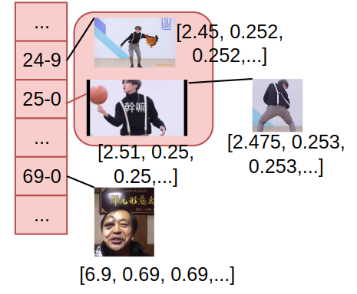
Limitations of Existing Works
Data-dependent Indexing:
E.g., Product Quantization, Learned Hashing
Pros: Conceptually more accurate and efficient
Utilizing the property of data
Cons: Costly update
As data property changes on the fly
Reconstruct the indexing of existing data
Notes:
The first category is data dependent indexing, which build the indexes based one the data properties.
The property can be centroid as used in product quantization, or be defined under some arbitrary function in the learned hash.
By considering data properties, we can conceptually achieve more accurate and efficient indexing. However, updating such index is usually costly due to the changed data properties. For instance, if the new image of men in braces playing basketball is inserted, we need to reconstruct the indexing of existing data, such as move the picture of ‘men playing chicken’
to different indexing position.

Slide 7
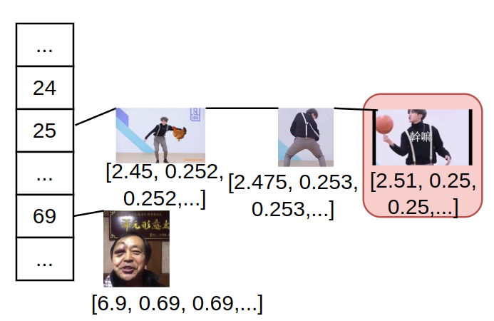
Limitations of Existing Works
Data-independent Indexing
E.g., Locality Sensitive Hash
Pros: No need to update indexing rules
E.g., pre-defined hash functions
Cons: Inaccurate during online DB update
Properties of data is completely ignored
Pre-defined hash
Notes:
On the contrary, we can also use pre-defined rules, like the LSH to conduct data independent indexing. For instance, the new image can be hashed directly to the shown place using LSH. Although much less udate is required, the accuracy can be low due to the ignorance of data properties.

Slide 8
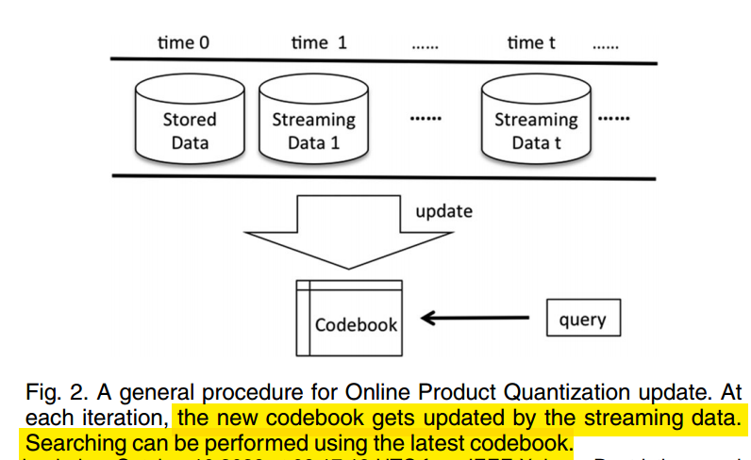
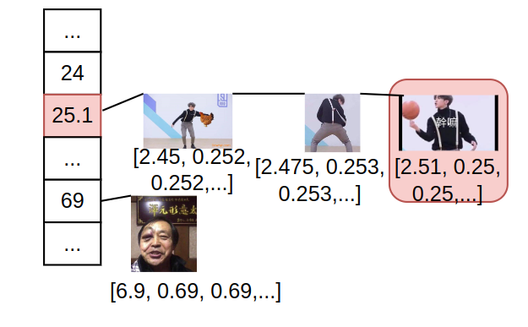
Online Product Quantization: The New Approach
Incrementally update the data-dependent indexing
Extend the product quantization (PQ) [1] to streaming data
Update the PQ codebook without retraining all the collected data
Update the indexing of new data only, keep that for old data the same
Update into 25.1 based on the property of new data [2.51, …]
Encode and insert new data
Indexing of old data are not changed
Product quantization for nearest neighbor search. TPAMI 2010.
Notes:
Faced with the limitations of either low accuracy or low accuracy in existing woks, they propose the online product quantilization. The key insight of online PQ is to achieve data-dependent indexing in an incremental and one-shot manner. Specifically, online PQ is a natural extension of PQ to streaming data. While PQ requires to rebuild codebook on all obtained data, online PQ just use the new data for updating. For instance, the original 25 indexing object is updated into 25.1, due to the new image. Moreover, all of the existing data can remain unchanged in their encoding and code book.

Slide 9
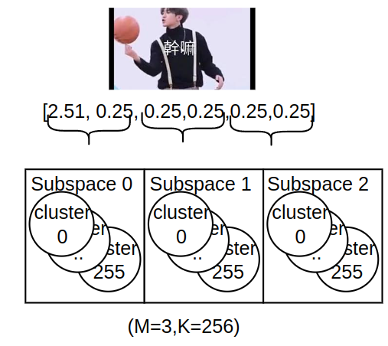
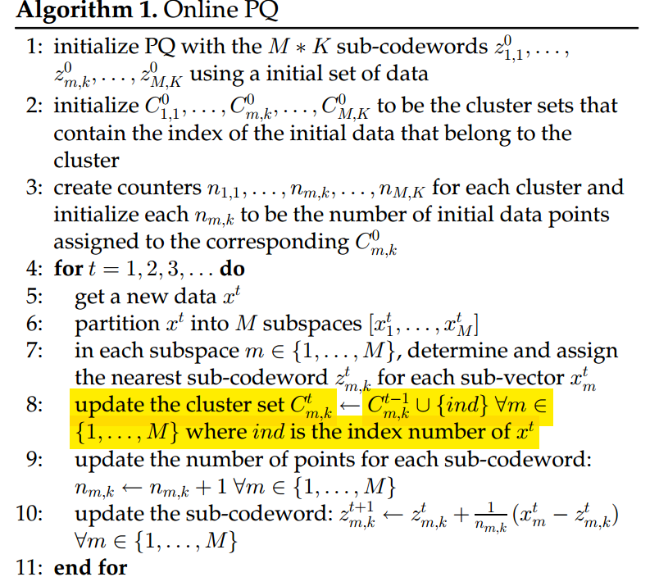
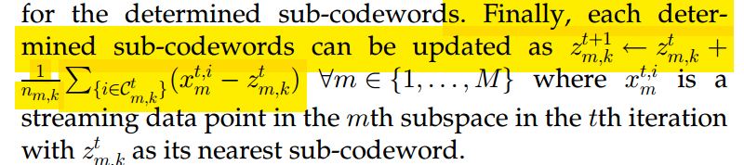
Algorithm Overview*
Inherit the ‘subspace’ from PQ to partition dimensions.
More space-efficient than w/o dimension partition
No change to the number of clusters in each subspace
Update the centroid by a simple addition
Also allow mini-batch
Compute a batch
*Please refer to Section 4 in their paper for the error bound proofs
Notes:
Here is an overview of algorithm, and please fere to xxx for its error bounds.
Inherit the ‘subspace’ from PQ to partition dimensions.
For instance, the 6-dimension data shown here is partitioned into 3 subspaces, and each subspace have 256 clusters in this example.
.For each subspace, online PQ does not change the number of clusters, but only update centroid by a simple linear equation.
Such update can also be extended to minibatch, as we can accumulate the contribution of the whole mini batch to update the centroid.

Slide 10
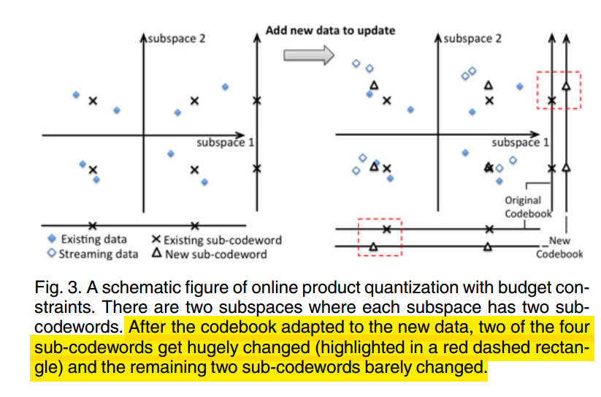
Further Optimization: Partial Codebook Update
Not all subspace need to be updated
Only update those with 'significant' changes
Can apply tuning knob to constrain #changed subspaces
Notes:
Online PQ can be further optimized by partial codebook update.
Specifically.xxx

Slide 11
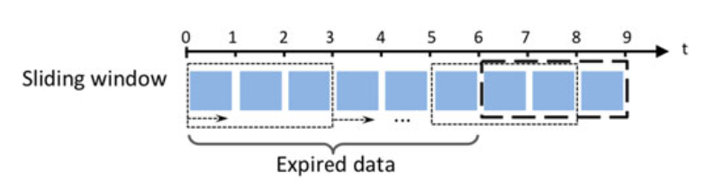
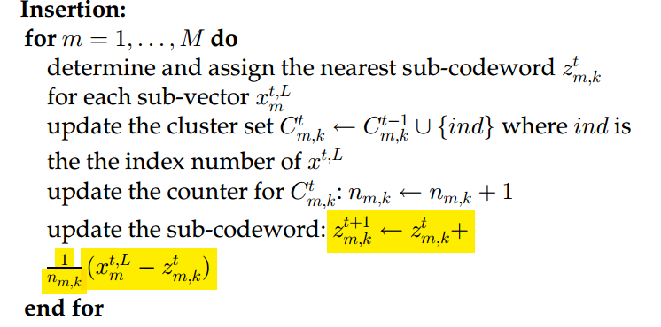
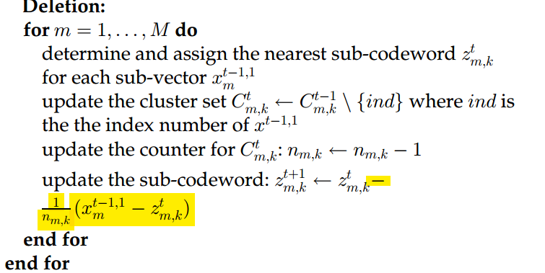
Extension to Sliding Window: Delta +/-
Centroid update is a simple arithmetic operation
Insertion: add the impacts of new data
Deletion: subtract the impacts of expired data
Notes:
Online PQ can be also extended to sliding window case due to its simple arithmtic updating on the centroidc. We can just add the impact of new data for insertion, and substract its impacts for deletion.

Slide 12
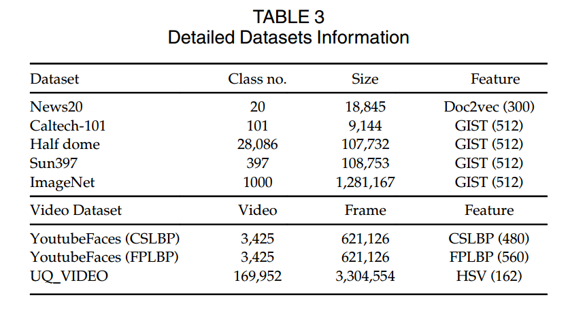
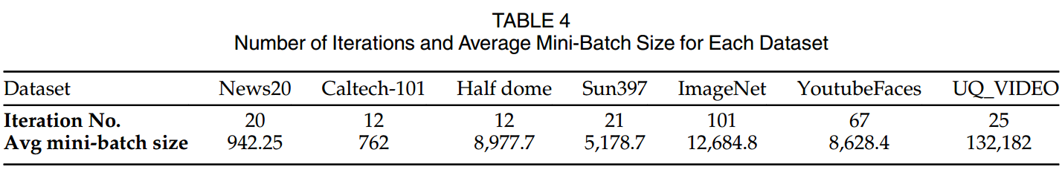
Experiment Setup
Real-world datasets of image and video
3.1GHz CPU, 120 GB Mem, Matlab
Online baselines: SSBC, OSH, OH, AdaptHash
Batch baselines: PQ, SH, IsoH, ITQ, KMH
Notes:
Here is an experimental set upxxx

Slide 13
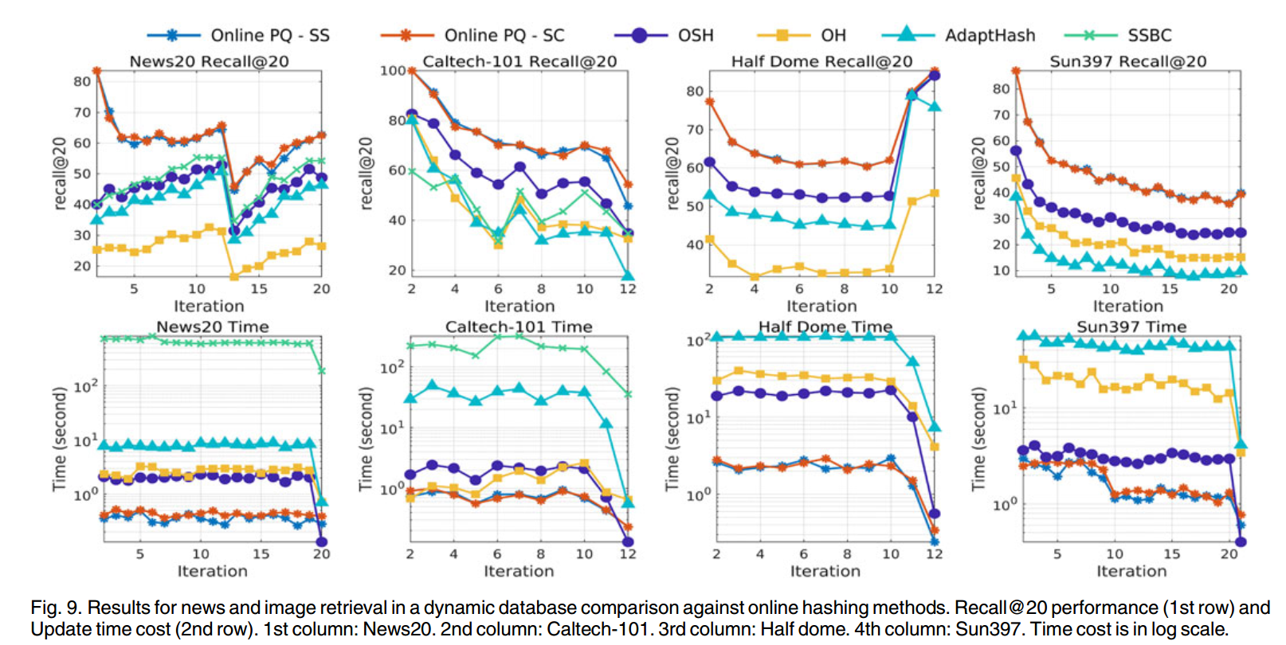
Always Outperform the Online Baselines Significantly
ANN Quality: the higher, the better
Processing Overhead: the lower, the better

Slide 14
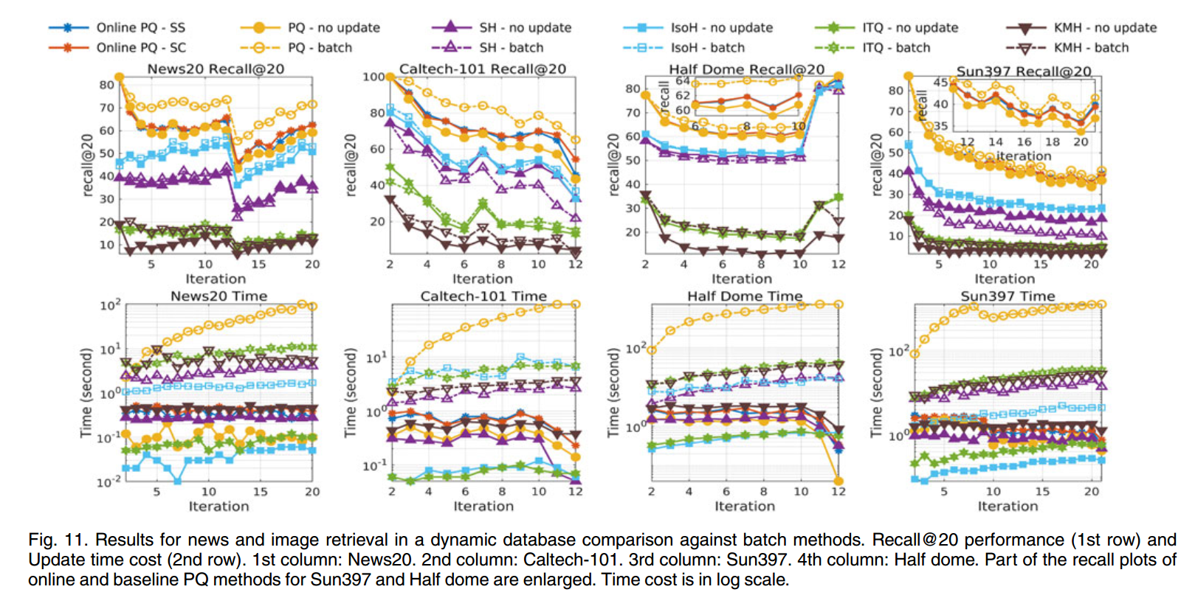
Better Tradeoff between Accuracy and Overhead Compared with Batch Baselines

Slide 15
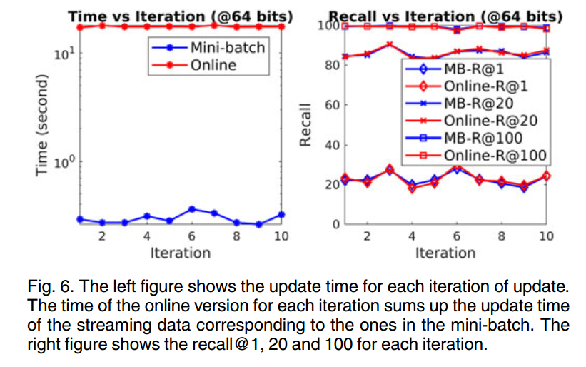
Mini Batch is Less Costly than Eager Online Processing

Slide 16
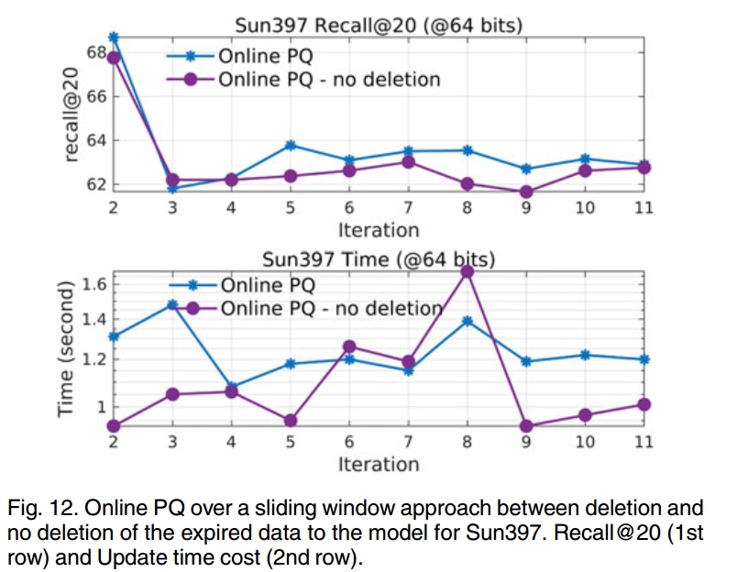
Expiring Old Data is Helpful for Quality in Sliding Window

Slide 17
Other Evaluation in the Paper
Impacts of tuning knobs inherited from PQ
e.g., the M and K settings
Impacts of their own tuning knobs
e.g., the updating constraints on #subspaces

Slide 18
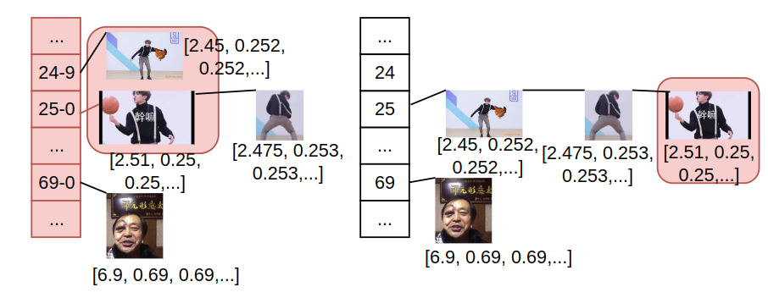
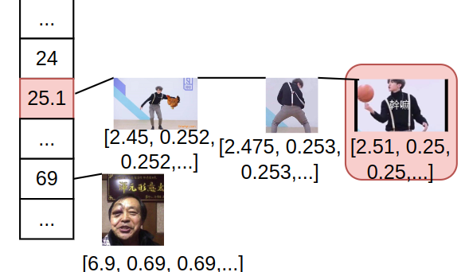
Conclusion
Online PQ accommodates well with streaming data
Low-overhead, online, and data-dependent indexing
Comparable accuracy as batch methods
Support of sliding window
Extend the online update to other methods beyond PQ in the future.
Problem setting
State-of-art: high overhead or low accuracy
Online PQ: accommodates better

Slide 19
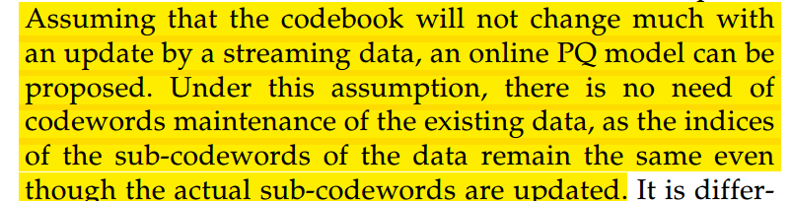
Assumptions and Limitations
Despite bounded error, not intended for severe concept drift
(Section 2)

